Slide 1
그래프그리기 모듈 (matplotlib)
중앙대학교 소프트웨어학부 신재진

Slide 2

matplotlib 설치
matplotlib (맷플롯립) : Plotting을 위한 파이썬 모듈
Matplotlib: Visualization with Python
Matplotlib is a comprehensive library for creating static, animated, and interactive visualizations in Python.
설치
C:\> pip install matplotlib
예제 코드 다운로딩
https://matplotlib.org/_downloads/85d9be59fab8a02517f514497a37cf68/gallery_python.zip ( https://matplotlib.org/gallery/index.html )
www.acornpub.co.kr/book/matplotlib
C:\Users\yourPcName\AppData\Roaming\Python\Python38\site-packages 밑에 설치됨
https://matplotlib.org/

Slide 3
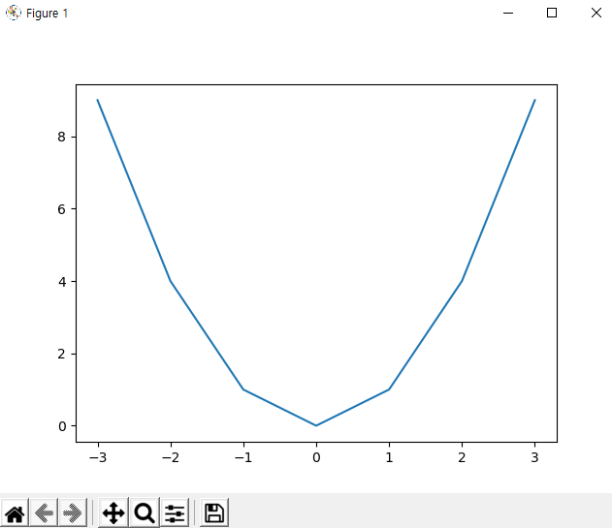
matplotlib 설치 확인, 예제
간단한 예제1
설명
Reset original view
Save the figure
import matplotlib.pyplot as plt
X = range(-3,4)
Y = [x**2 for x in X]
plt.plot(X,Y)
plt.show()

Slide 4
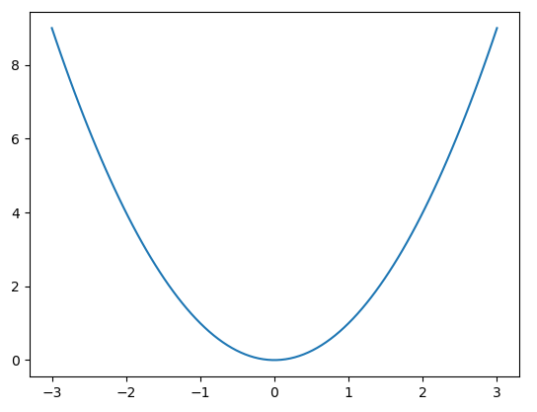
numpy 활용, 예제
간단한 예제2
import matplotlib.pyplot as plt
import numpy as np
X = np.linspace(-3,3,100)
Y = [x**2 for x in X]
plt.plot(X,Y)
plt.show()

Slide 5
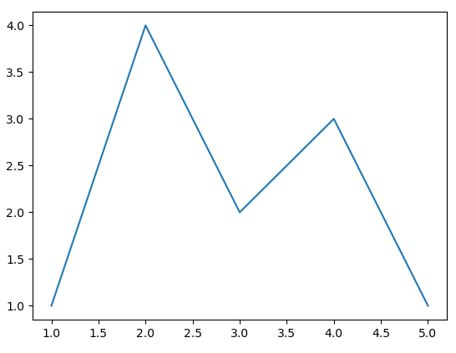
꺽은 선 그래프
꺽은 선 그래프
import matplotlib.pyplot as plt
X = [1, 2, 3, 4, 5]
Y = [1, 4, 2, 3, 1]
plt.plot(X,Y)
plt.show()

Slide 6
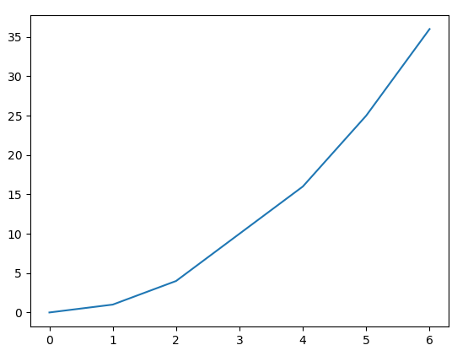
파일 데이터로 부터 꺽은선
파일 데이터로 부터 꺽은선
my_data.txt인 평문 텍스트 파일
import matplotlib.pyplot as plt
X, Y = [], []
for line in open("my_data.txt", "r"):
values = [float(s) for s in line.split()]
X.append(values[0])
Y.append(values[1])
plt.plot(X,Y)
plt.show()
0 0
1 1
2 4
4 16
5 25
6 36
출처: 알렉상드르 드베르 지음/이문호 옮김, matplotlib을 이용한 데이터 시각화 프로그래밍, 에이콘, 2015

Slide 7
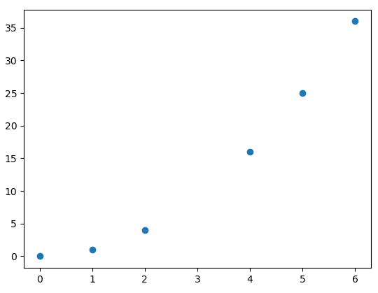
점 그리기
점 그리기
my_data.txt인 평문 텍스트 파일
import matplotlib.pyplot as plt
X, Y = [], []
for line in open("my_data.txt", "r"):
values = [float(s) for s in line.split()]
X.append(values[0])
Y.append(values[1])
plt.scatter(X,Y)
plt.show()
0 0
1 1
2 4
4 16
5 25
6 36

Slide 8
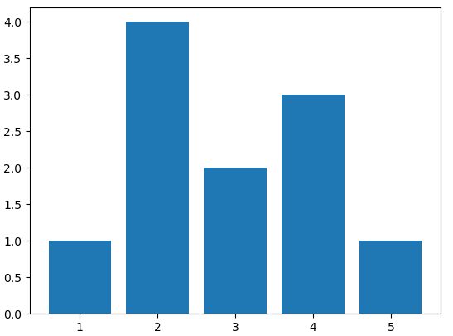
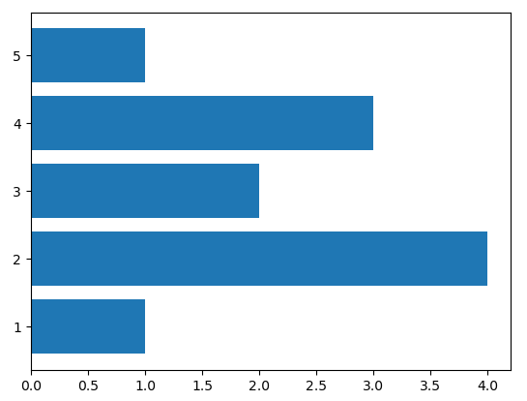
막대 그래프, 수평 막대 그래프
막대 그래프
수평 막대 그래프
import matplotlib.pyplot as plt
X = [1, 2, 3, 4, 5]
Y = [1, 4, 2, 3, 1]
plt.bar(X,Y)
plt.show()
import matplotlib.pyplot as plt
X = [1, 2, 3, 4, 5]
Y = [1, 4, 2, 3, 1]
plt.barh(X,Y)
plt.show()

Slide 9
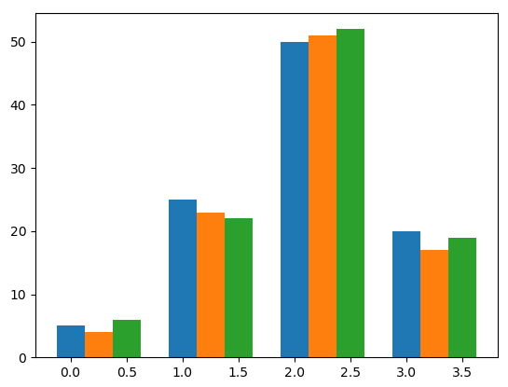
다중 막대 그래프
다중 막대 그래프
import matplotlib.pyplot as plot
data = [[5., 25., 50., 20.],
[4., 23., 51., 17.],
[6., 22., 52., 19.]]
plot.bar(range(4), data[0], width = 0.25)
plot.bar([x + 0.25 for x in range(4)], data[1], width = 0.25)
plot.bar([x + 0.50 for x in range(4)], data[2], width = 0.25)
plot.show()
출처: 알렉상드르 드베르 지음/이문호 옮김, matplotlib을 이용한 데이터 시각화 프로그래밍, 에이콘, 2015

Slide 10
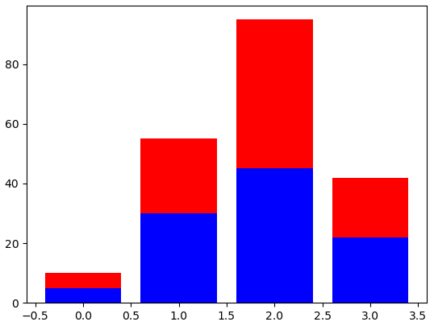
분할 막대 그래프
분할 막대 그래프
import matplotlib.pyplot as plot
A = [5., 30., 45., 22.]
B = [5., 25., 50., 20.]
X = range(4)
plot.bar(X, A, color = 'b')
plot.bar(X, B, color = 'r', bottom = A)
plot.show()
https://matplotlib.org/3.3.3/api/_as_gen/matplotlib.pyplot.bar.html
matplotlib.pyplot.bar(x, height, width=0.8, bottom=None, *, align='center', data=None, **kwargs) Make a bar plot.
x: The x coordinates of the bars. height: The height(s) of the bars.
width: The width(s) of the bars. bottom: The y coordinate(s) of the bars bases.
align: Alignment of the bars to the x coordinates: color: The colors of the bar faces.
edgecolor: The colors of the bar edges. linewidth: Width of the bar edge(s). If 0, don't draw edges.
tick_label: The tick labels of the bars. Default: None (Use default numeric labels.)
hatch: {'/', '\', '|', '-', '+', 'x', 'o', 'O', '.', '*'}
출처: 알렉상드르 드베르 지음/이문호 옮김, matplotlib을 이용한 데이터 시각화 프로그래밍, 에이콘, 2015

Slide 11
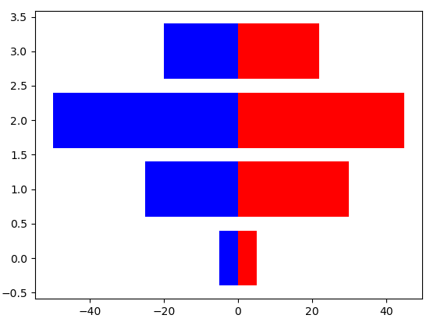
양방향 막대 그래프
양방향 막대 그래프
import matplotlib.pyplot as plot
women_pop = [5., 30., 45., 22.]
men_pop = [5., 25., 50., 20.]
X = range(4)
plot.barh(X, women_pop, color = 'r')
plot.barh(X, [-value for value in men_pop], color = 'b')
plot.show()
출처: 알렉상드르 드베르 지음/이문호 옮김, matplotlib을 이용한 데이터 시각화 프로그래밍, 에이콘, 2015

Slide 12
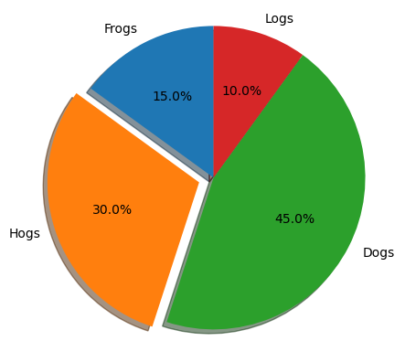
원형 (Pie) 차트
원형 차트
import matplotlib.pyplot as plt
# Pie chart, where the slices will be ordered and
# plotted counter-clockwise:
labels = 'Frogs', 'Hogs', 'Dogs', 'Logs'
sizes = [15, 30, 45, 10]
explode = (0, 0.1, 0, 0) # only "explode" the 2nd slice (i.e. 'Hogs')
ax = plt.axes()
ax.pie(sizes, explode=explode, labels=labels, autopct='%.1f%%',
shadow=True, startangle=90)
ax.axis('equal') # Equal aspect ratio ensures that pie is drawn as a circle.
plt.show()
https://matplotlib.org/3.3.3/api/_as_gen/matplotlib.axes.Axes.pie.html
Axes.pie(x, explode=None, labels=None, colors=None, autopct=None, shadow=False, startangle=0, counterclock=True) # Plot a pie chart.
x: 1D-array, wedge sizes.
explode: An array which specifies the fraction of the radius with which to offset each wedge.
labels: A sequence of strings providing the labels for each wedge
colors: A sequence of colors through which the pie chart will cycle.
autopct: If it is a format string, the label will be fmt % pct. If it is a function, it will be called.
shadow: Draw a shadow beneath the pie.
startangle: The angle by which the start of the pie is rotated, counterclockwise from the x-axis.
counterclock: Specify fractions direction, clockwise or counterclockwise.
https://matplotlib.org/gallery/pie_and_polar_charts/pie_features.html

Slide 13
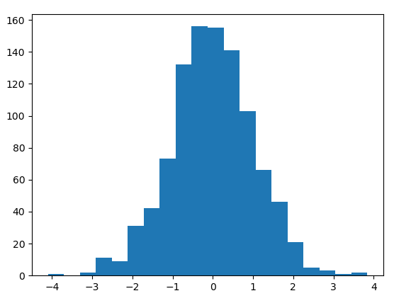
히스토그램 (Histogram)
히스토그램
import random
import matplotlib.pyplot as plot
count = 1000
X = [random.gauss(0, 1.) for i in range(count)]
plot.hist(X, bins = 20)
plot.show()
https://matplotlib.org/3.3.3/api/_as_gen/matplotlib.pyplot.hist.html
matplotlib.pyplot.hist(x, bins=None, density=False, cumulative=False, **kwargs) # Plot a histogram.
x: array. Input values.
bins: If bins is an integer, it defines the number of equal-width bins in the range.
cumulative
density: If True, draw and return a probability density:
출처: 알렉상드르 드베르 지음/이문호 옮김, matplotlib을 이용한 데이터 시각화 프로그래밍, 에이콘, 2015

Slide 14
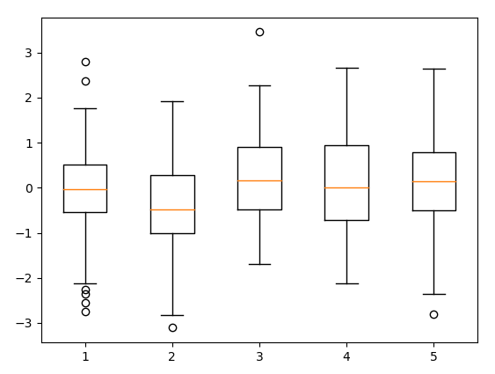
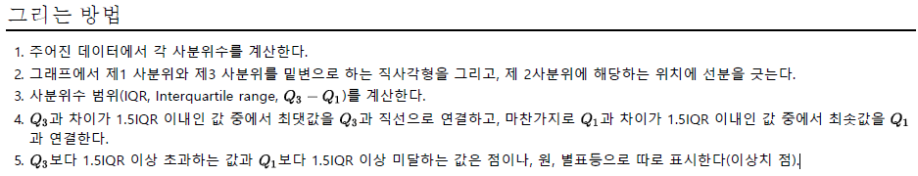
상자 그림 (Boxplot)
상자그림 그리기
import numpy
import matplotlib.pyplot as plot
data = numpy.random.randn(100, 5)
plot.boxplot(data)
plot.show()
출처: ko.wikipedia.org/w/index.php?title=상자_수염_그림
출처: 알렉상드르 드베르 지음/이문호 옮김, matplotlib을 이용한 데이터 시각화 프로그래밍, 에이콘, 2015

Slide 15
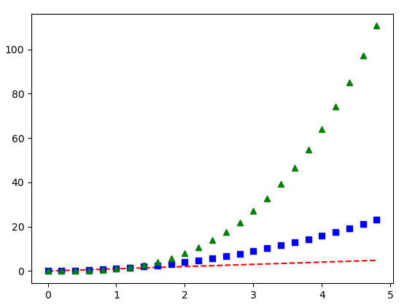
여러 곡선 그리기
여러 곡선 그리기
import numpy as np
import matplotlib.pyplot as plt
# evenly sampled time at 200ms intervals
t = np.arange(0., 5., 0.2)
# red dashes, blue squares and green triangles
plt.plot(t, t, 'r--', t, t**2, 'bs', t, t**3, 'g^')
plt.show()
#
plt.plot(t, t, 'r--')
plt.plot(t, t**2, 'bs')
plt.plot(t, t**3, 'g^')
https://matplotlib.org/

Slide 16
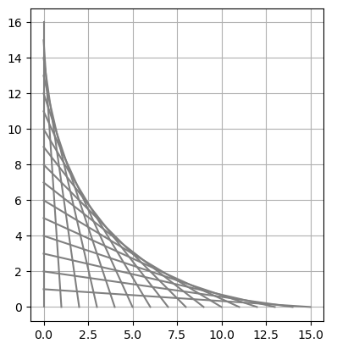
선 추가
SKIP
선 추가
import matplotlib.pyplot as plot
N = 16
for i in range(N):
plot.gca().add_line( plot.Line2D( (0, i),
(N - i, 0), color = '.5') )
plot.grid(True)
plot.axis('scaled')
plot.show()
matplotlib.pyplot.gca(**kwargs) # Get the current axes, creating one if necessary.
matplotlib.axes.Axes.add_line(line) # Add a Line2D to the axes' lines; return the line
matplotlib.lines.Line2D(xdata, ydata,...) # A line - the line can have both a solid linestyle connecting all the vertices, and a marker at each vertex
plot.axis('scaled') # Set equal scaling. (Circles are circular)
출처: 알렉상드르 드베르 지음/이문호 옮김, matplotlib을 이용한 데이터 시각화 프로그래밍, 에이콘, 2015

Slide 17
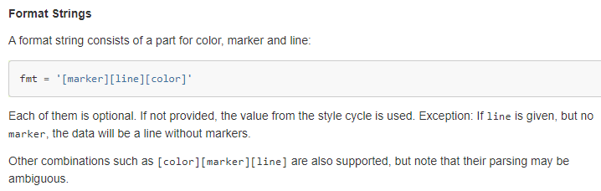
matplotlib.pyplot.plot API (1/3)
호출
사용예
Format string
plot([x], y, [fmt], *, data=None, **kwargs)
plot([x], y, [fmt], [x2], y2, [fmt2], ..., **kwargs)
>>> plot(x, y) # plot x and y using default line style and color
>>> plot(x, y, 'bo') # plot x and y using blue circle markers
>>> plot(y) # plot y using x as index array 0..N-1
>>> plot(y, 'r+') # ditto, but with red plusses
출처: https://matplotlib.org/api/_as_gen/matplotlib.pyplot.plot.html

Slide 18
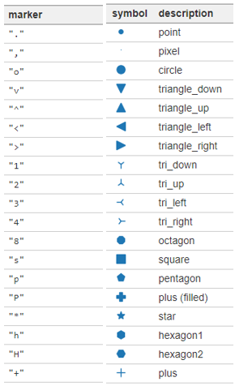
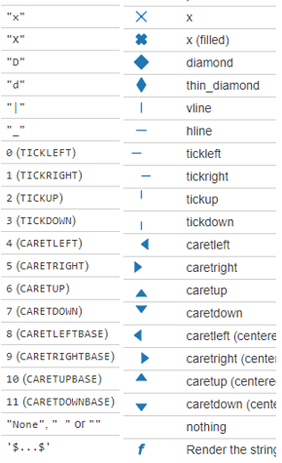
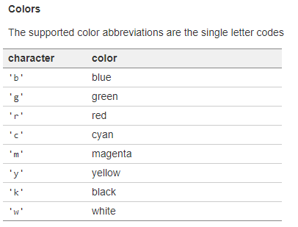
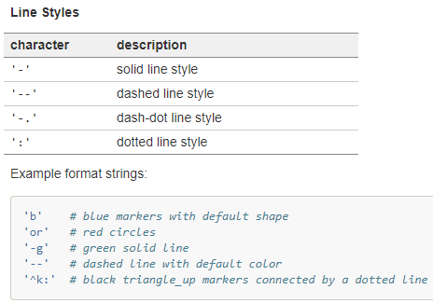
matplotlib.pyplot.plot API (2/3)
You can additionally use any matplotlib.colors spec, e.g. full names ('green') or hex strings ('#008000').
출처: https://matplotlib.org/api/_as_gen/matplotlib.pyplot.plot.html#matplotlib.pyplot.plot

Slide 19
matplotlib.pyplot.plot API (3/3)
**kwargs : 속성들
>>> plot([1, 2, 3], [1, 2, 3], 'go-', label='line 1', linewidth=2)
>>> plot([1, 2, 3], [1, 4, 9], 'rs', label='line 2')
alpha float or None (the alpha value used for blending)
color or c color
fillstyle {'full', 'left', 'right', 'bottom', 'top', 'none'}
label object
linestyle or ls {'-', '--', '-.', ':', '', (offset, on-off-seq), ...}
linewidth or lw float (in points)
marker marker style string, Path or MarkerStyle
markeredgecolor or mec color
markeredgewidth or mew float
markerfacecolor or mfc color
markerfacecoloralt or mfcalt color
markersize or ms float (in points)
출처: https://matplotlib.org/api/_as_gen/matplotlib.pyplot.plot.html#matplotlib.pyplot.plot

Slide 20
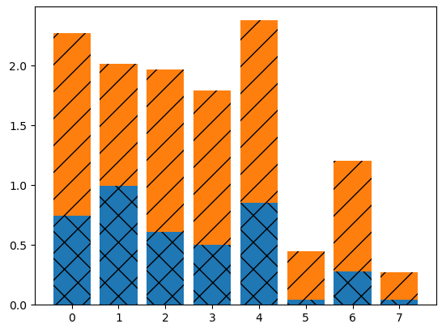
채움 패턴 제어
채움 패턴 제어
import numpy
import matplotlib.pyplot as plot
N = 8
A = numpy.random.random(N)
B = numpy.random.random(N)
plot.bar(range(N), A, hatch = 'x')
plot.bar(range(N), A + B, bottom = A, hatch = '/')
plot.show()
https://matplotlib.org/3.3.3/api/_as_gen/matplotlib.pyplot.bar.html
matplotlib.pyplot.bar(x, height, width=0.8, bottom=None, *, align='center', data=None, **kwargs) # Make a bar plot.
x: The x coordinates of the bars. height: The height(s) of the bars.
width: The width(s) of the bars. bottom: The y coordinate(s) of the bars bases.
hatch: {'/', '\', '|', '-', '+', 'x', 'o', 'O', '.', '*'}
출처: 알렉상드르 드베르 지음/이문호 옮김, matplotlib을 이용한 데이터 시각화 프로그래밍, 에이콘, 2015

Slide 21
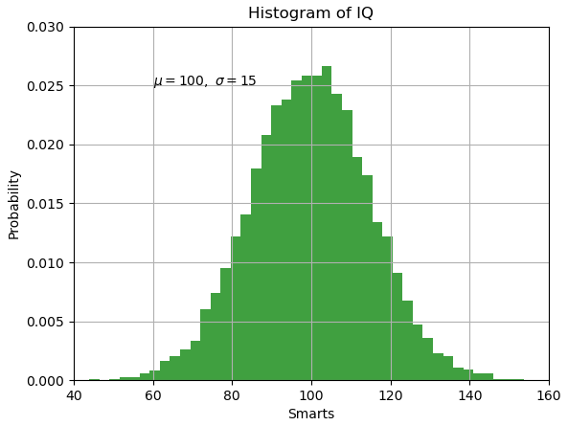

축 레이블
축 레이블 등
import numpy as np
import matplotlib.pyplot as plt
mu, sigma = 100, 15
x = mu + sigma * np.random.randn(10000)
# the histogram of the data
n, bins, patches = plt.hist(x, 50, density=1, facecolor='g', alpha=0.75)
plt.xlabel('Smarts')
plt.ylabel('Probability')
plt.title('Histogram of IQ')
plt.text(60, .025, r'$\mu=100,\ \sigma=15$')
plt.axis([40, 160, 0, 0.03])
plt.grid(True)
plt.show()
https://matplotlib.org/tutorials/text/mathtext.html
달러기호($)안에 수식을 기술하는 LaTeX방식 설명.
https://matplotlib.org/

Slide 22
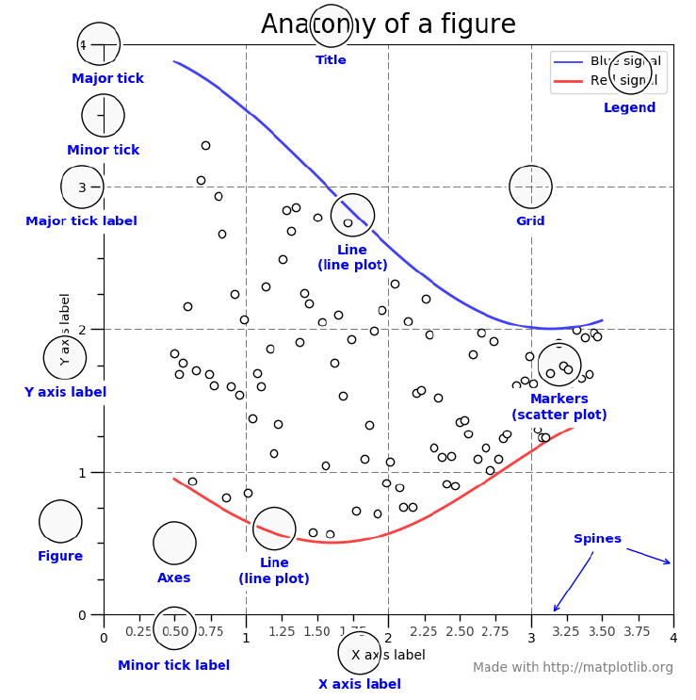
그래프 구성 요소들
https://matplotlib.org/

Slide 23
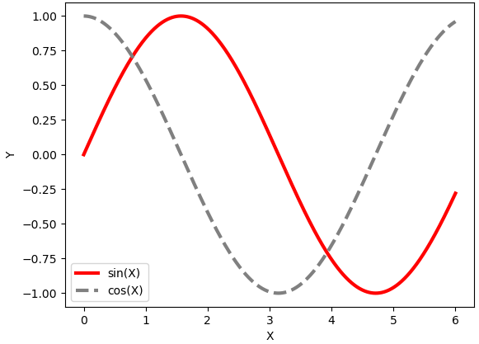
범례 (legend) 추가
범례 (legend) 추가
import numpy
import matplotlib.pyplot as plot
X = numpy.linspace(0, 6, 1024)
Y1 = numpy.sin(X)
Y2 = numpy.cos(X)
plot.xlabel('X')
plot.ylabel('Y')
plot.plot(X, Y1, c = 'r', lw = 3., label = 'sin(X)')
plot.plot(X, Y2, c = '.5', ls = '--', lw = 3., label = 'cos(X)')
plot.legend()
plot.show()
출처: 알렉상드르 드베르 지음/이문호 옮김, matplotlib을 이용한 데이터 시각화 프로그래밍, 에이콘, 2015

Slide 24
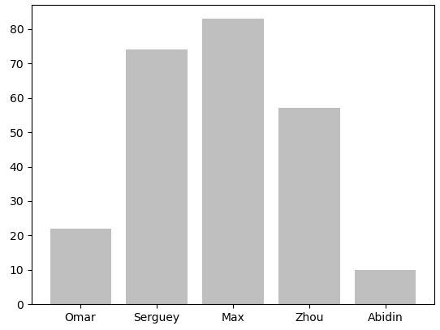
눈금 레이블 붙이기
눈금 레이블 붙이기
import numpy
import matplotlib.ticker as ticker
import matplotlib.pyplot as plot
name_list = ['Omar', 'Serguey', 'Max', 'Zhou', 'Abidin']
value_list = numpy.random.randint( 0, 99, size = len(name_list) )
pos_list = numpy.arange( len(name_list) )
ax = plot.axes()
ax.xaxis.set_major_locator( ticker.FixedLocator( (pos_list) ) )
ax.xaxis.set_major_formatter( ticker.FixedFormatter( name_list ) )
plot.bar(pos_list, value_list, color = '.75', align = 'center')
plot.show()
출처: 알렉상드르 드베르 지음/이문호 옮김, matplotlib을 이용한 데이터 시각화 프로그래밍, 에이콘, 2015

Slide 25
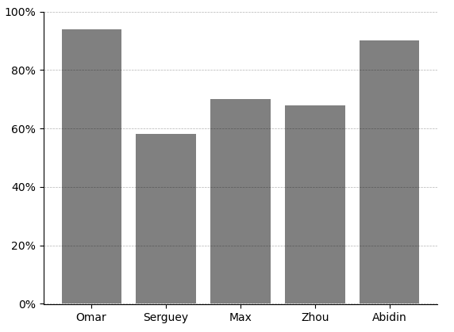
import numpy as np
import matplotlib.ticker as ticker
import matplotlib.pyplot as plot
name_list = ['Omar', 'Serguey', 'Max', 'Zhou', 'Abidin']
len_name_list = len(name_list)
value_list = np.random.randint(0, 99, size = len_name_list)
pos_list = tuple( np.arange(len_name_list) )
ax = plot.axes()
ax.xaxis.set_major_locator(ticker.FixedLocator( pos_list ))
ax.xaxis.set_major_formatter(ticker.FixedFormatter( name_list ))
## Remove the plot frame lines. They are unnecessary here.
ax.spines['top'].set_visible(False)
ax.spines['bottom'].set_visible(True)
ax.spines['right'].set_visible(False)
ax.spines['left'].set_visible(True)
## Ensure that the axis ticks only show up on the bottom and
## left of the plot.
## Ticks on the right and top of the plot are generally unnecessary.
ax.get_xaxis().tick_bottom()
ax.get_yaxis().tick_left()
## Limit the range of the plot to only where the data is.
## Avoid unnecessary whitespace.
ax.set_ylim(-0.25, 100)
## Set a fixed location and format for ticks.
ax.set_yticks( range(0, 110, 20) )
## Use automatic StrMethodFormatter creation
ax.yaxis.set_major_formatter('{x:.0f}%')
## Provide tick lines across the plot to help your viewers trace along
## the axis ticks. Make sure that the lines are light and small so they
## don't obscure the primary data lines.
ax.grid(True, 'major', 'y', ls='--', lw=.5, c='k', alpha=.3)
plot.bar(pos_list, value_list, color = '0.5', align = 'center')
plot.show()
눈금 표시 Formatting 예
grid(b=None, which='major', axis='both', **kwargs)
b : bool or None, optional.
Whether to show the grid lines.
which : {'major', 'minor', 'both'}, optional
The grid lines to apply the changes on.
axis : {'both', 'x', 'y'}, optional
The axis to apply the changes on
https://matplotlib.org/gallery/showcase/bachelors_degrees_by_gender.html 를 수정

Slide 26
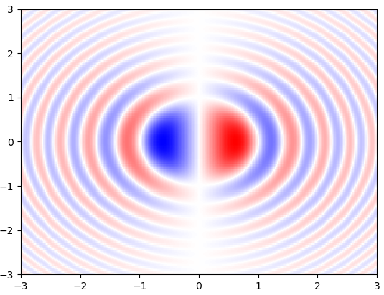
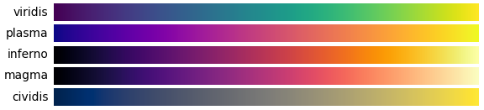
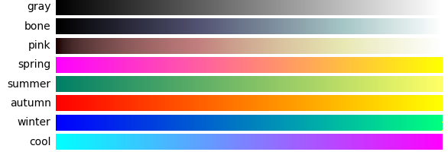
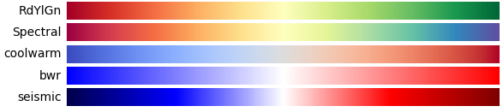
2D 스칼라장 시각화
2D 스칼라장 시각화
import numpy
from matplotlib import pyplot as plot
import matplotlib.cm as cm
n = 256
x = numpy.linspace(-3., 3., n)
y = numpy.linspace(-3., 3., n)
X, Y = numpy.meshgrid(x, y)
Z = X * numpy.sinc(X ** 2 + Y ** 2)
plot.pcolormesh(X, Y, Z, cmap = cm.bwr)
plot.show()
https://matplotlib.org/3.3.3/tutorials/colors/colormaps.html
출처: 알렉상드르 드베르 지음/이문호 옮김, matplotlib을 이용한 데이터 시각화 프로그래밍, 에이콘, 2015

Slide 27
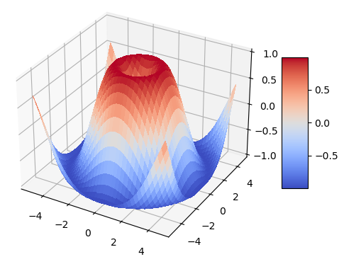
3D 시각화 (3D surface, color map)
import matplotlib.pyplot as plt
from matplotlib import cm
import numpy as np
fig, ax = plt.subplots(subplot_kw={"projection": "3d"})
# ax = plt.axes(projection="3d")
# Make data.
X = np.arange(-5, 5, 0.25)
Y = np.arange(-5, 5, 0.25)
X, Y = np.meshgrid(X, Y)
R = np.sqrt(X**2 + Y**2)
Z = np.sin(R)
# Plot the surface.
surf = ax.plot_surface(X, Y, Z, cmap=cm.coolwarm,
linewidth=0, antialiased=False)
# Customize the z axis.
ax.set_zlim(-1.01, 1.01)
# Add a color bar which maps values to colors.
fig.colorbar(surf, shrink=0.5, aspect=5)
plt.show()
https://matplotlib.org/3.3.3/api/_as_gen/matplotlib.pyplot.subplots.html
matplotlib.pyplot.subplots(nrows=1, ncols=1, subplot_kw =None, **fig_kw) Create a figure and a set of subplots. nrows, ncols: Number of rows/columns of the subplot grid.
subplot_kw: Dict with keywords passed to the add_subplot call used to create each subplot.
Returns: fig: Figure ax: axes.Axes or array of Axes
https://matplotlib.org/gallery/mplot3d/surface3d.html 수정

Slide 28
Pyplot의 함수들 (matplotlib.pyplot) (1/6)
Function Description
acorr Plot the autocorrelation of x.
angle_spectrum Plot the angle spectrum.
annotate Annotate the point xy with text text.
arrow Add an arrow to the axes.
autoscale Autoscale the axis view to the data (toggle).
axes Add an axes to the current figure and make it the current axes.
axhline Add a horizontal line across the axis.
axhspan Add a horizontal span (rectangle) across the axis.
axis Convenience method to get or set some axis properties.
axline Add an infinitely long straight line.
axvline Add a vertical line across the axes.
axvspan Add a vertical span (rectangle) across the axes.
bar Make a bar plot.
barbs Plot a 2D field of barbs.
barh Make a horizontal bar plot.
box Turn the axes box on or off on the current axes.
boxplot Make a box and whisker plot.
broken_barh Plot a horizontal sequence of rectangles.
cla Clear the current axes.
clabel Label a contour plot.
clf Clear the current figure.
clim Set the color limits of the current image.
출처: https://matplotlib.org/api/pyplot_summary.html

Slide 29
Pyplot의 함수들 (matplotlib.pyplot) (2/6)
close Close a figure window.
cohere Plot the coherence between x and y.
colorbar Add a colorbar to a plot.
contour Plot contours.
contourf Plot contours.
csd Plot the cross-spectral density.
delaxes Remove an Axes (defaulting to the current axes) from its figure.
draw Redraw the current figure.
draw_if_interactive
errorbar Plot y versus x as lines and/or markers with attached errorbars.
eventplot Plot identical parallel lines at the given positions.
figimage Add a non-resampled image to the figure.
figlegend Place a legend on the figure.
fignum_exists Return whether the figure with the given id exists.
figtext Add text to figure.
figure Create a new figure, or activate an existing figure.
fill Plot filled polygons.
fill_between Fill the area between two horizontal curves.
fill_betweenx Fill the area between two vertical curves.
findobj Find artist objects.
gca Get the current axes, creating one if necessary.
gcf Get the current figure.
gci Get the current colorable artist.
출처: https://matplotlib.org/api/pyplot_summary.html

Slide 30
Pyplot의 함수들 (matplotlib.pyplot) (3/6)
get Return the value of an object's property, or print all of them.
get_figlabels Return a list of existing figure labels.
get_fignums Return a list of existing figure numbers.
getp Return the value of an object's property, or print all of them.
grid Configure the grid lines.
hexbin Make a 2D hexagonal binning plot of points x, y.
hist Plot a histogram.
hist2d Make a 2D histogram plot.
hlines Plot horizontal lines at each y from xmin to xmax.
imread Read an image from a file into an array.
imsave Save an array as an image file.
imshow Display data as an image, i.e., on a 2D regular raster.
install_repl_displayhook Install a repl display hook so that any stale figure are automatically redrawn when control is returned to the repl.
ioff Turn the interactive mode off.
ion Turn the interactive mode on.
isinteractive Return if pyplot is in "interactive mode" or not.
legend Place a legend on the axes.
locator_params Control behavior of major tick locators.
loglog Make a plot with log scaling on both the x and y axis.
magnitude_spectrum Plot the magnitude spectrum.
margins Set or retrieve autoscaling margins.
matshow Display an array as a matrix in a new figure window.
출처: https://matplotlib.org/api/pyplot_summary.html

Slide 31
Pyplot의 함수들 (matplotlib.pyplot) (4/6)
minorticks_off Remove minor ticks from the axes.
minorticks_on Display minor ticks on the axes.
new_figure_manager Create a new figure manager instance.
pause Run the GUI event loop for interval seconds.
pcolor Create a pseudocolor plot with a non-regular rectangular grid.
pcolormesh Create a pseudocolor plot with a non-regular rectangular grid.
phase_spectrum Plot the phase spectrum.
pie Plot a pie chart.
plot Plot y versus x as lines and/or markers.
plot_date Plot data that contains dates.
polar Make a polar plot.
psd Plot the power spectral density.
quiver Plot a 2D field of arrows.
quiverkey Add a key to a quiver plot.
rc Set the current rcParams.
rc_context Return a context manager for temporarily changing rcParams.
rcdefaults Restore the rcParams from Matplotlib's internal default style.
rgrids Get or set the radial gridlines on the current polar plot.
savefig Save the current figure.
sca Set the current Axes to ax and the current Figure to the parent of ax.
scatter A scatter plot of y vs.
sci Set the current image.
semilogx Make a plot with log scaling on the x axis.
출처: https://matplotlib.org/api/pyplot_summary.html

Slide 32
Pyplot의 함수들 (matplotlib.pyplot) (5/6)
semilogy Make a plot with log scaling on the y axis.
set_cmap Set the default colormap, and applies it to the current image if any.
setp Set a property on an artist object.
show Display all open figures.
specgram Plot a spectrogram.
spy Plot the sparsity pattern of a 2D array.
stackplot Draw a stacked area plot.
stem Create a stem plot.
step Make a step plot.
streamplot Draw streamlines of a vector flow.
subplot Add a subplot to the current figure.
subplot2grid Create a subplot at a specific location inside a regular grid.
subplot_mosaic Build a layout of Axes based on ASCII art or nested lists.
subplot_tool Launch a subplot tool window for a figure.
subplots Create a figure and a set of subplots.
subplots_adjust Adjust the subplot layout parameters.
suptitle Add a centered title to the figure.
switch_backend Close all open figures and set the Matplotlib backend.
table Add a table to an Axes.
text Add text to the axes.
thetagrids Get or set the theta gridlines on the current polar plot.
tick_params Change the appearance of ticks, tick labels, and gridlines.
ticklabel_format Configure the ScalarFormatter used by default for linear axes.
출처: https://matplotlib.org/api/pyplot_summary.html

Slide 33
Pyplot의 함수들 (matplotlib.pyplot) (6/6)
tight_layout Adjust the padding between and around subplots.
title Set a title for the axes.
tricontour Draw contour lines on an unstructured triangular grid.
tricontourf Draw contour regions on an unstructured triangular grid.
tripcolor Create a pseudocolor plot of an unstructured triangular grid.
triplot Draw a unstructured triangular grid as lines and/or markers.
twinx Make and return a second axes that shares the x-axis.
twiny Make and return a second axes that shares the y-axis.
uninstall_repl_displayhook Uninstall the matplotlib display hook.
violinplot Make a violin plot.
vlines Plot vertical lines.
xcorr Plot the cross correlation between x and y.
xkcd Turn on xkcd sketch-style drawing mode.
xlabel Set the label for the x-axis.
xlim Get or set the x limits of the current axes.
xscale Set the x-axis scale.
xticks Get or set the current tick locations and labels of the x-axis.
ylabel Set the label for the y-axis.
ylim Get or set the y-limits of the current axes.
yscale Set the y-axis scale.
yticks Get or set the current tick locations and labels of the y-axis.
출처: https://matplotlib.org/api/pyplot_summary.html

